Slide 1
Welcome!
And thanks for participating.

Slide 2
Trials look like this
A cue appears
You will see some moving dots on the screen
You will press a button based on the cue and the moving dots
Advance through the next three slides to see how that looks.

Slide 3

a
s
a
Press either key to continue

Slide 4

This is an embedded youtube video: in the experiment, this will be fullscreen. If you aren’t using ppt (e.g. Libreoffice Impress) you will need to use the link in your browser:
https://youtu.be/bjRN1O1oxjI

Slide 5
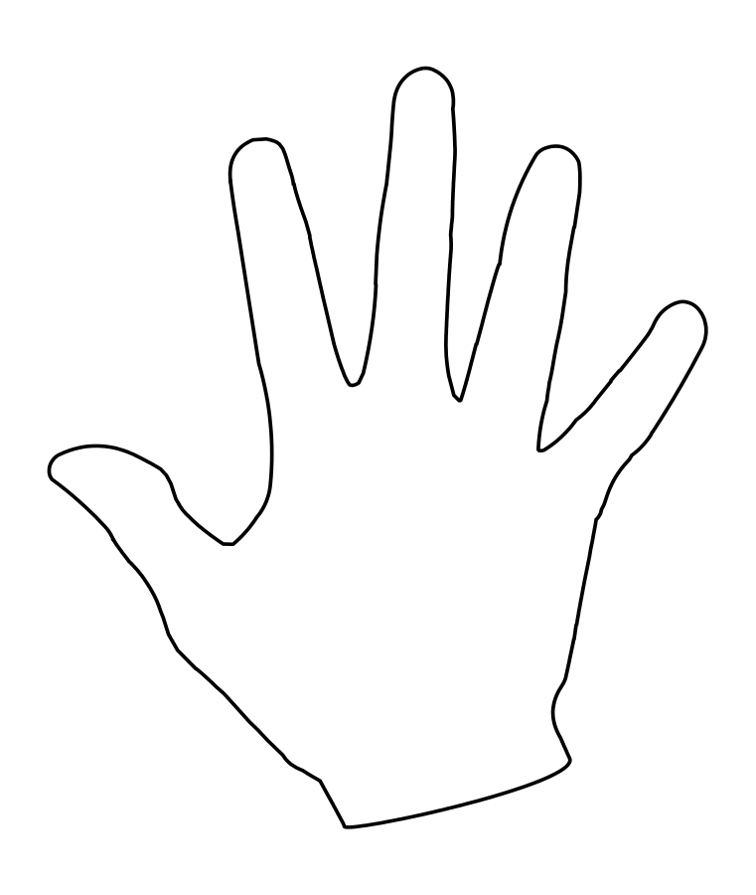
Button 1
Button 2
s
a

Slide 6
Detail
Let me explain the task in a bit more detail. In each trial, some of the dots are moving randomly and the rest are moving all together in one (coherent) direction. The cue lets you know which button to press depending on what direction the coherent dots are moving in on that trial. Advance through the next three slides to see how that would play out.

Slide 7
a
s
a
Press either key to continue

Slide 8
Press ‘a’
Press ‘s’

Slide 9
Going in the direction of ‘a’
Going in the direction of ‘s’
s
a

Slide 10
Example one
Let’s do a couple of examples here, with embedded videos of moving dots.

Slide 11
a
s
a
Press either key to continue

Slide 12
If you aren’t using ppt (e.g. Libreoffice Impress) you will need to use the link in your browser:
https://youtu.be/BgxBwGVRzVg

Slide 14
s
a

Slide 15
Example two

Slide 16
a
s
a
Press either key to continue

Slide 17
If you aren’t using ppt (e.g. Libreoffice Impress) you will need to use the link in your browser:
https://youtu.be/HNvaz8koxb8

Slide 19
s
a

Slide 20
Some final points

Slide 21
The cue can change
The cue will only appear every once in a while, to remind you of what the rule is. Also, the cue might change from time to time, to tell you that different directions are important, so please pay attention! See the next slide for an example of a different variation of the cue.

Slide 22
a
s
a
Press either key to continue

Slide 23
Be careful about which dots are ‘coherent’
Because some of the dots are moving randomly, you might occasionally see a couple of random dots ‘kind of’ moving in the same direction. That doesn’t count as coherent. You only care about the dots that are definitely moving all together in one single direction. See the next slide for an example: here the coherent dots are moving to the top right, but you occasionally get two or three that look like they are kind of moving together downward, or to the bottom left. Ignore those!

Slide 24
If you aren’t using ppt (e.g. Libreoffice Impress) you will need to use the link in your browser:
https://youtu.be/6CLYWHtgazs

Slide 25
Some trials are easy, some are hard
Sometimes it will be easy to see what direction the dots are moving in, because there will be lots of coherent dots. Sometimes there will be less coherent dots and it will be harder to see. Also, sometimes the dots will be moving in a direction where it’s hard to tell whether it should be an ‘a’ or ‘s’ direction. This is all part of the experiment. Just do your best! I’m just as interested in mistakes as I am in correct answers. Which brings me to the last and most important point:

Slide 26
Always answer!
(even if you aren’t sure)
try to be as accurate and as fast as possible but
always answer

Slide 27
Ready?
Great! See the instructions text file for your next steps!

